Slide 1

Charter school
updates
Quarter 1
September 11, 2025
1

Slide 2
Special Projects Updates
  R.A.N. Reminders
  Reimbursement Reminders
  Taggable Items Reminders
Agenda
Grant Specific
  School Hardening
  IDEA Individuals with Disabilities Education Act
  Stronger Connections
  UNISIG
  Title II & Title IV
2

Slide 3
Special Projects Updates
  R.A.N. Reminders
  Reimbursement Reminders
  Taggable Items Reminders
Agenda
Grant Specific
  School Hardening
  IDEA Individuals with Disabilities Education Act
  Stronger Connections
  UNISIG
  Title II & Title IV
3

Slide 4

Special Projects
updates
4

Slide 5

Reasonable
Allocable
Necessary
Would an average person think this is a sensible way to spend grant funds?
Can the connection between this cost and the project's objectives be clearly demonstrated?
Is this expense required to accomplish our grant objectives?
Reasonable costs are expenses that a prudent person would consider sensible and appropriate under the circumstances.
For a cost to be allocable, it must have a clear connection to the grant and contribute to its objectives.
Necessary costs are expenses that are essential for achieving the goals of the grant project.
5

Slide 6



Reimbursement Process
Cover Letter
Proof of Payment
Invoice
6

Slide 7
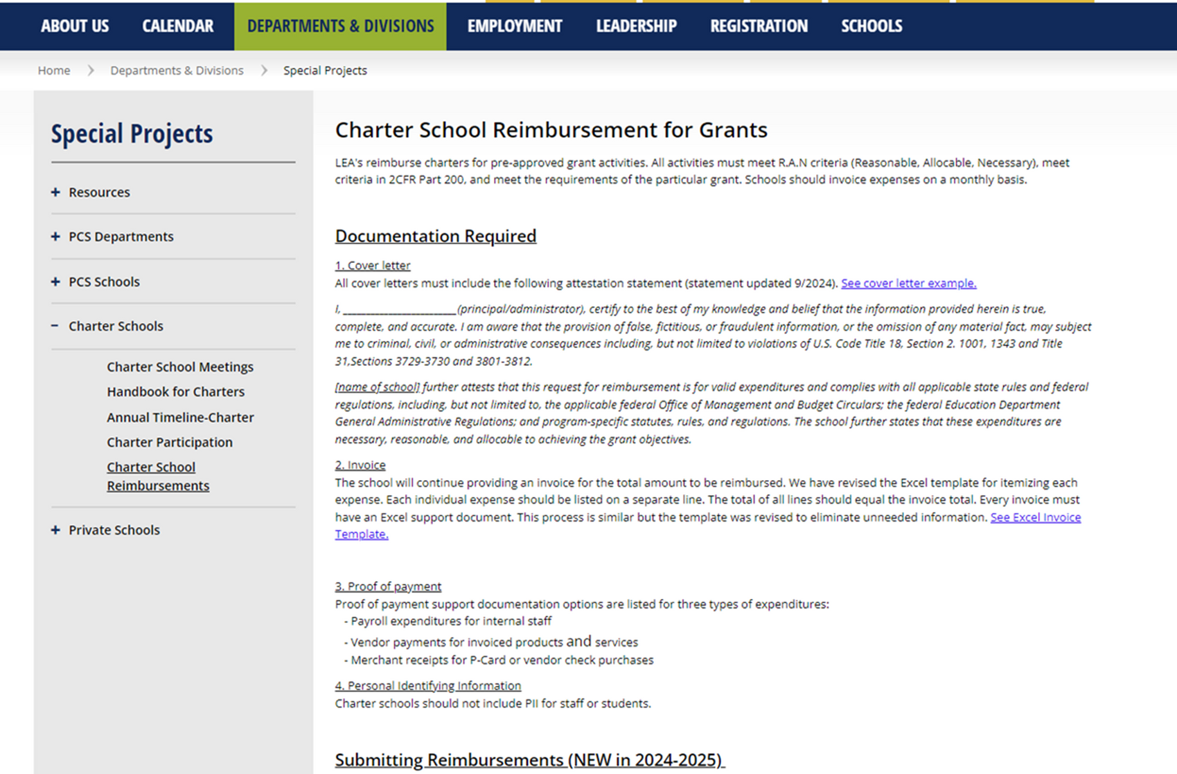
Reimbursement Process
7
Notes:
Title I will also be moving to this process.

Slide 8
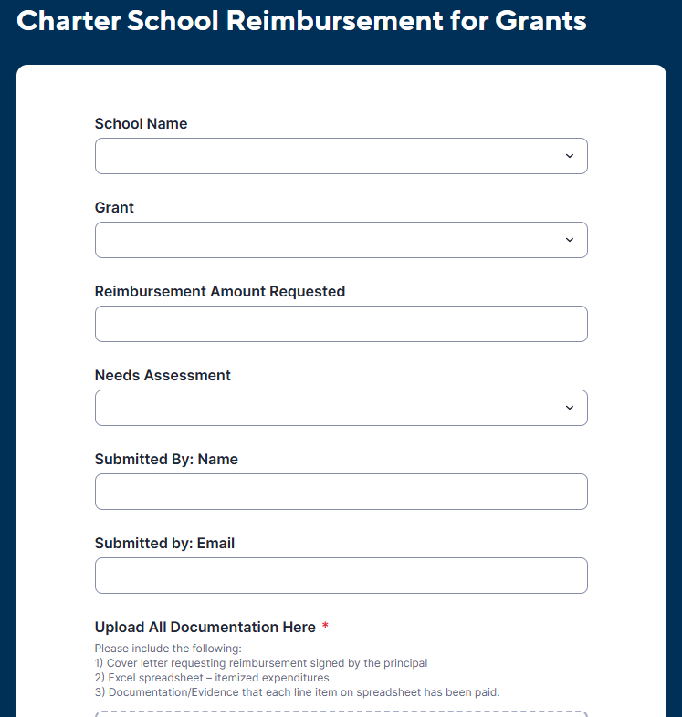
Reimbursement Process
8

Slide 9
Reimbursement Process
NEW! Title 1
9

Slide 10

Reimbursement Hangups
  Bank Back Up- partial months
  Addition - Total amount on itemized spreadsheet
  Tax - Not removed on purchases, receipts, etc.
  Frequency - Combining many months
  Overabundance - Too much unnecessary back-up documentation

Slide 11

Taggable Items
Please make sure that when you receive tags for taggable items that you complete the form that comes with them which provides us with the serial number. When this is returned to purchasing, they complete the asset in TERMS officially making it part of inventory and attached to the grant.
We need these forms ASAP and will now be making a follow up request as part of the process every time.
It’s NOT just a “checkmark” item - It’s really important!
11

Slide 12
Special Projects Updates
  R.A.N. Reminders
  Reimbursement Reminders
  Taggable Items Reminders
Agenda
Grant Specific
  School Hardening
  IDEA Individuals with Disabilities Education Act
  Stronger Connections
  UNISIG
  Title II & Title IV
12

Slide 13

School Hardening Grant
Grant 3289:
  Must reimburse before the Thanksgiving Holidays (due by November 22)
  Program Period from July 1st 2023 to January 31st 2026
Grant 3288:
  Awarded last week
  May begin reimbursements January 2026
  Program Period from July 1st 2024 to January 31st 2027
13
Notes:
Please let the charters know they must reimburse 3289 before the Thanksgiving holidays. Once 3289 closes in January 2026, schools will be able to reimburse 3288 which was awarded last week

Slide 14

Individuals with Disabilities act
Thank You!
  To all schools for collaborating on the new Intent to Participate process
  This will be an annual process going forward
Supply Funds:
  Emails with funds have been sent
  Reimbursement requests due by end of school year
  Funds must support students with disabilities (SWD)
  Must be: Reasonable • Allocable • Necessary
  Reimbursements due by June 1, 2026!
14

Slide 15








Excess Cost
IDEA Supplies must be directly tied to a student’s IEP and represent an excess cost—additional expenses a school incurs to provide special education and related services, above what is spent on an average student.
15

Slide 16

Stronger Connections
Grant Focus:
  School Climate, Behavior and Mental Health Institute
  MTSS, Social Work and Behavioral Services
  Supplemental Intensive Behavior Services through Board Certified Behavior Analysts
Next Steps:
  Submit your Needs Assessment if you have not already. (Next Due: October 15th)
  Once Needs Assessment is approved put in a request for reimbursement with the proper supporting documentation.
  Reimbursements due by August 1, 2026!
16

Slide 17

Unified School Improvement Grant
The Unified School Improvement Grant (UniSIG) provides federal funding to schools identified for improvement.
A school can be identified to receive UniSIG in any of the following three ways:
  Have an overall Federal Index below 41%
  Have a graduation rate at or below 67%
  Have a school grade of a D or F
Charter schools that qualify can use these funds for strategies and resources that support student learning and align with their School Improvement Plan. Reimbursements may be submitted for expenditures during the program period of August 1, 2025 to July 31, 2026.
17

Slide 18




Title II & Title IV
Updates
18

Slide 19
Title II and Title iv
Federal Freeze Updates
24-25 No Cost Extension (which means no roll forward in the spring)
25-26 Base Allocation only
19

Slide 20
Title II and Title iv
  Grant Period July 1, 2025 to June 30, 2026
  Reimbursements due by July 1, 2026
20

Slide 21
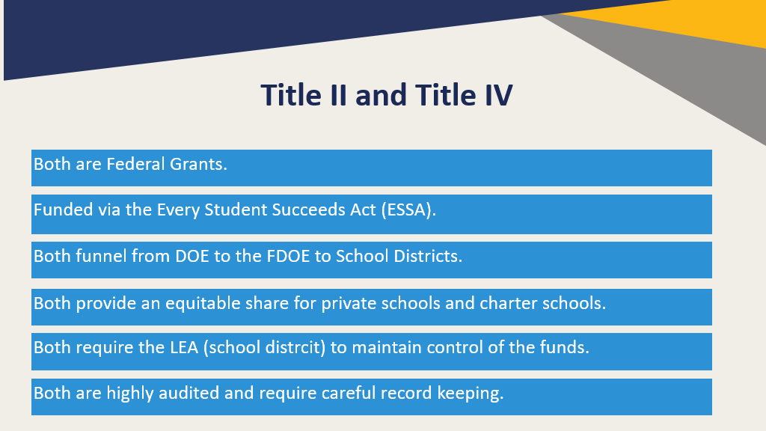
Title II and Title iv
21

Slide 22
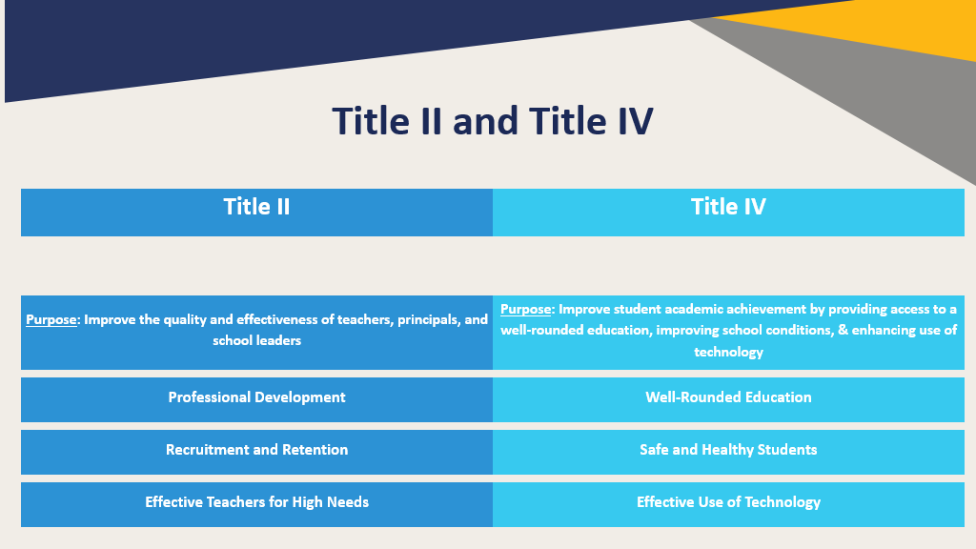
Title ii and title iv
22

Slide 23
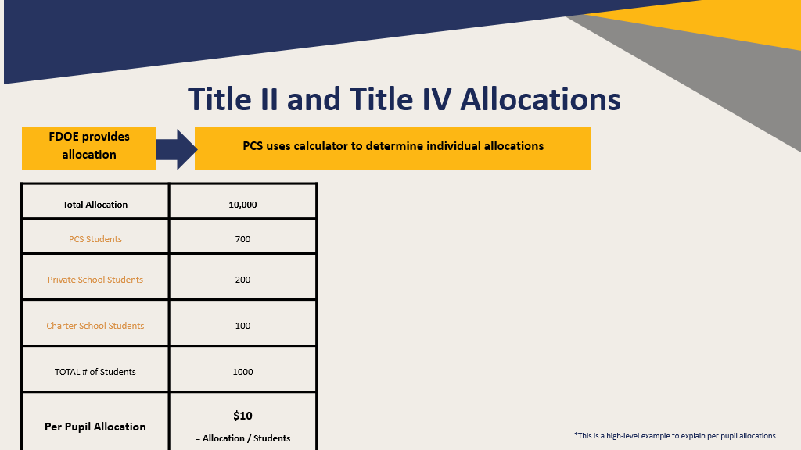
title ii and title iv allocations
23

Slide 24
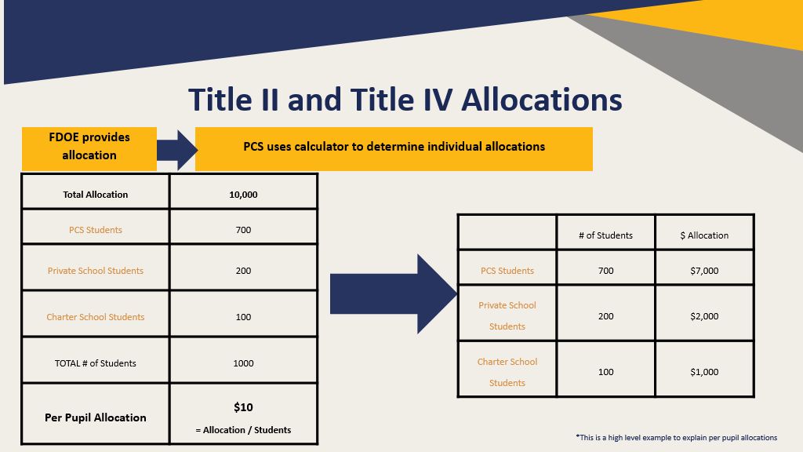
title ii and title iv allocations
24

Slide 25
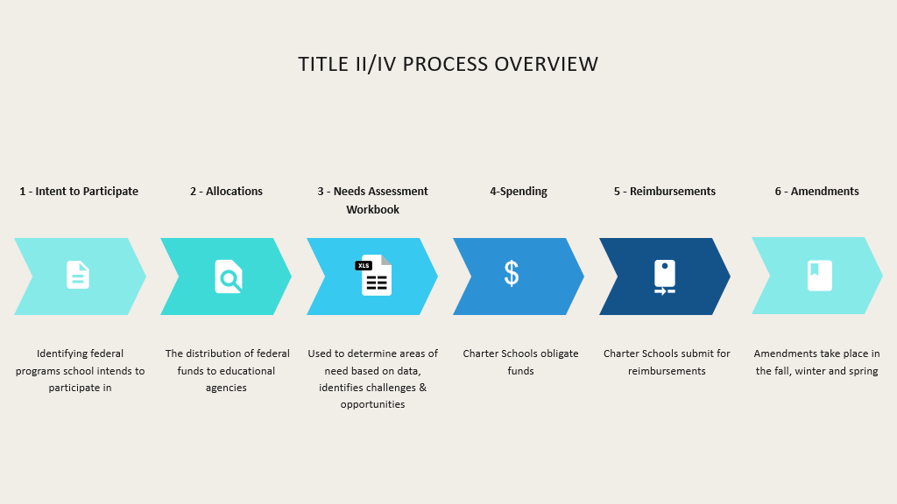
title ii & title iv process overview
25

Slide 26
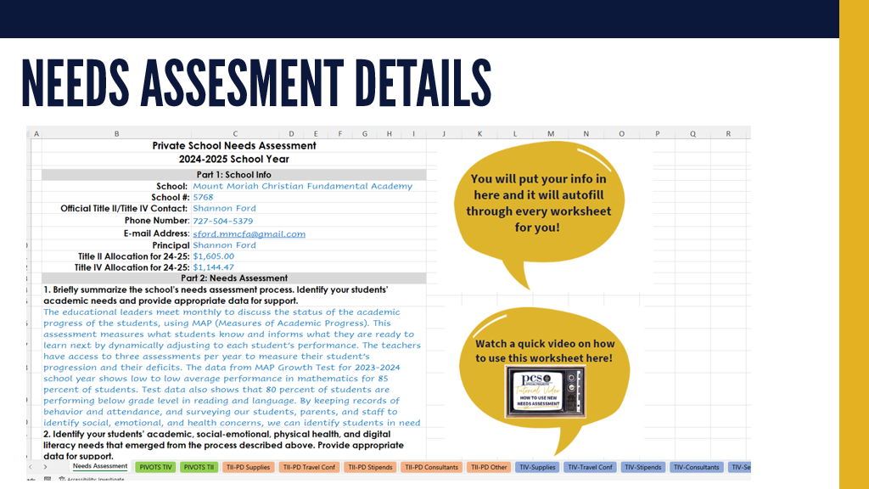
Needs Assessments
26

Slide 27
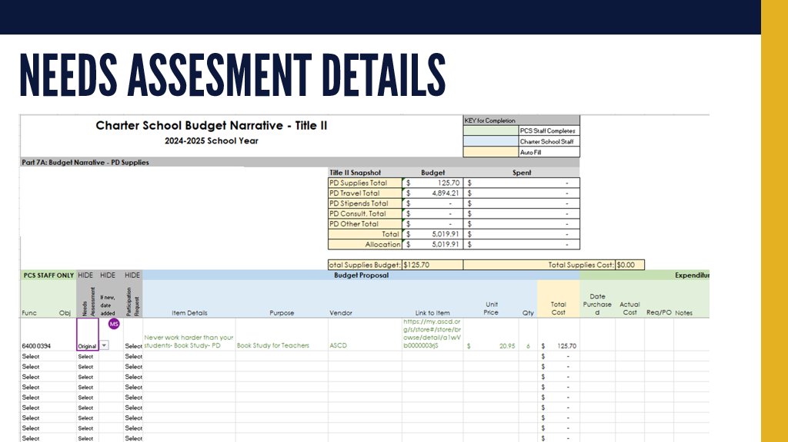
Needs Assessments
27

Slide 28
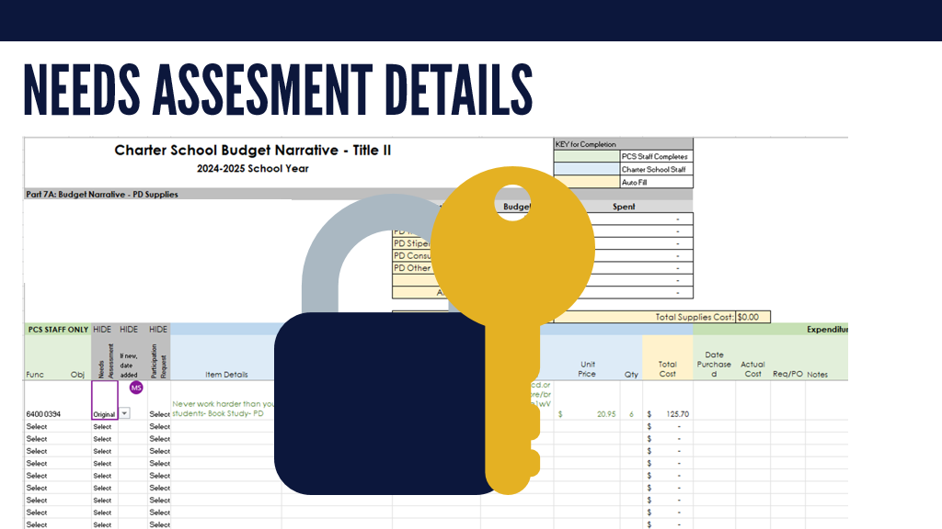
Needs Assessments
28

Slide 29
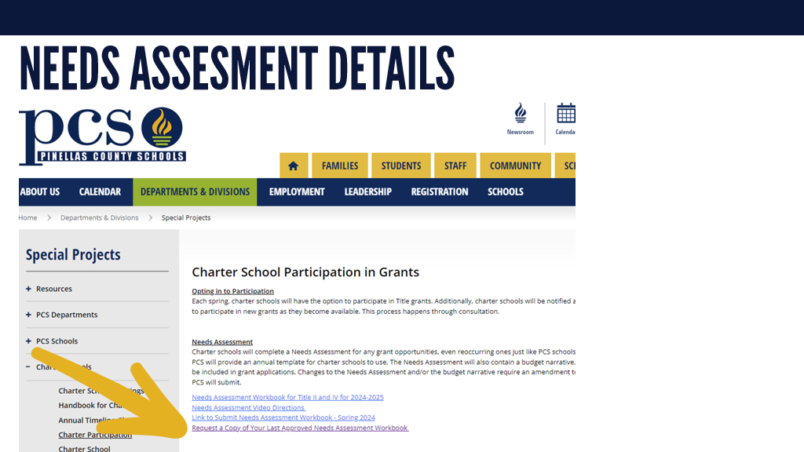
Needs Assessments
29

Slide 30
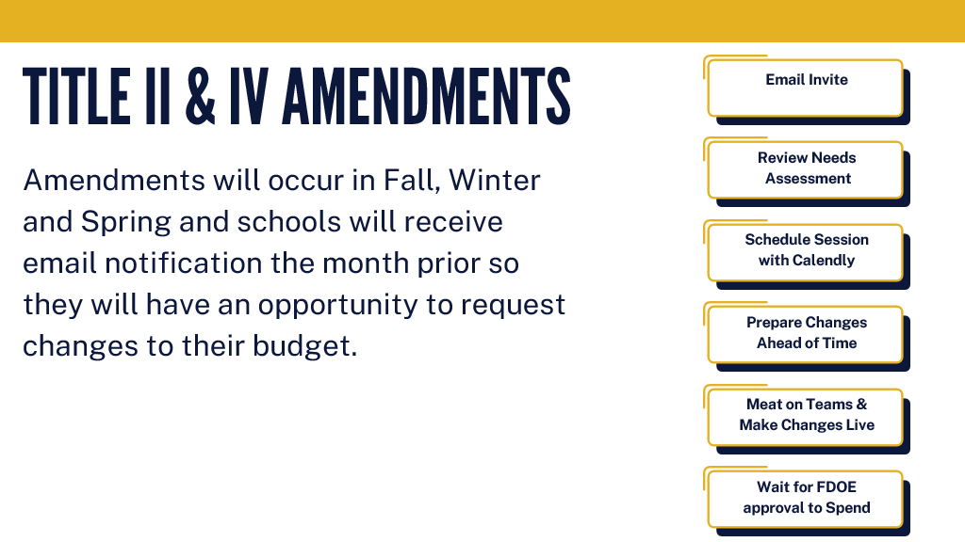
Amendments
30

Slide 31
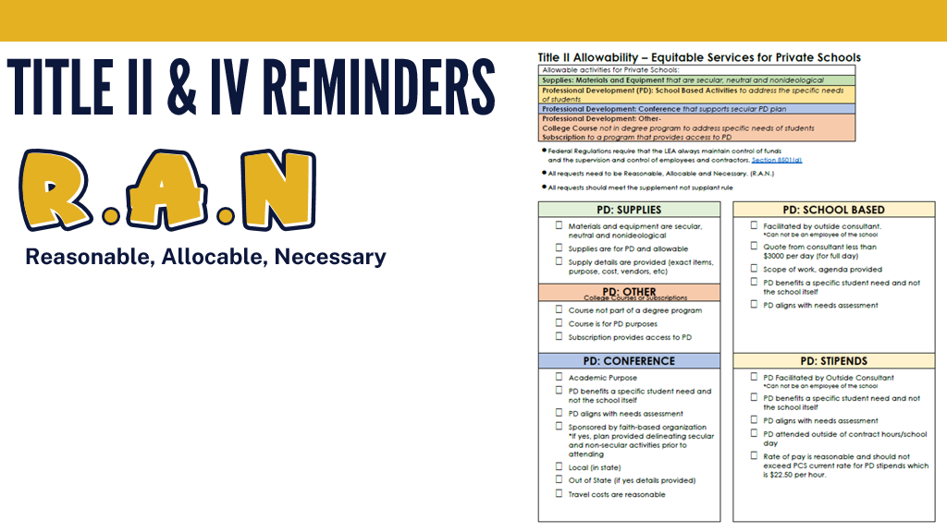

R.A.N.
31

